Slide 1
Impact of the Covid-19 pandemic on provision of acute care in Scotland.
Emma, Justyna, Tom, Louise

Slide 2
Summary
Introduce the Team
Project brief and our Approach
KPIs
Dashboard
Key findings

Slide 3
Team
Emma
Justyna
Louise
Tom

Slide 4

Project Brief
To what extent are the ‘winter crises’ reported by the media real?
2. How has the Covid-19 pandemic affected provision of acute care in Scotland?
Temporal: How has this issue changed over time? (Is it getting better or worse?)
Geographic: How does this issue differ between areas in Scotland? (Where should efforts be focussed?)
Demographic: Who is most affected by this issue? (Who should be targeted with efforts?)

Slide 5

Data
Hospital Activity by Speciality
Hospital Activity and Patient Demographics
Hospital Activity and Deprivation
Hospitalisations due to Covid 19
A&E attendances and performance data
Quarterly Hospital Beds Information - Datasets - Scottish Health and Social Care Open Data - nhs.scot
Delayed discharge data

Slide 6

The way to get started is to quit talking and begin doing.
Walt Disney

Slide 7




Project Timeline
FRIDAY
Familiarisation with the project brief, Trello set up, agreeing team rules for smooth progress and timeframe for the project, tasks division for the weekend.
1
MONDAY
Feedback the key findings from the assigned reports to the rest of the team, start the work on the wire frame and GitHub repo creation.
2
TUESDAY
Work on individual plots and create UI and server inputs for them.
3
WEDNESDAY
Put the individual plots together to create a dashboard. Testing, unifying and debugging
4
THURSDAY
Project review, report writing, presentation prep and tidying up Git repo.
5

Slide 8

Key Performance Indicators
Hospital Admissions
Length of hospital stay
Hospital beds availability

Slide 9
Dashboard

Slide 10
How has the Covid-19 pandemic affected provision of acute care in Scotland?
By Demographic

Slide 11
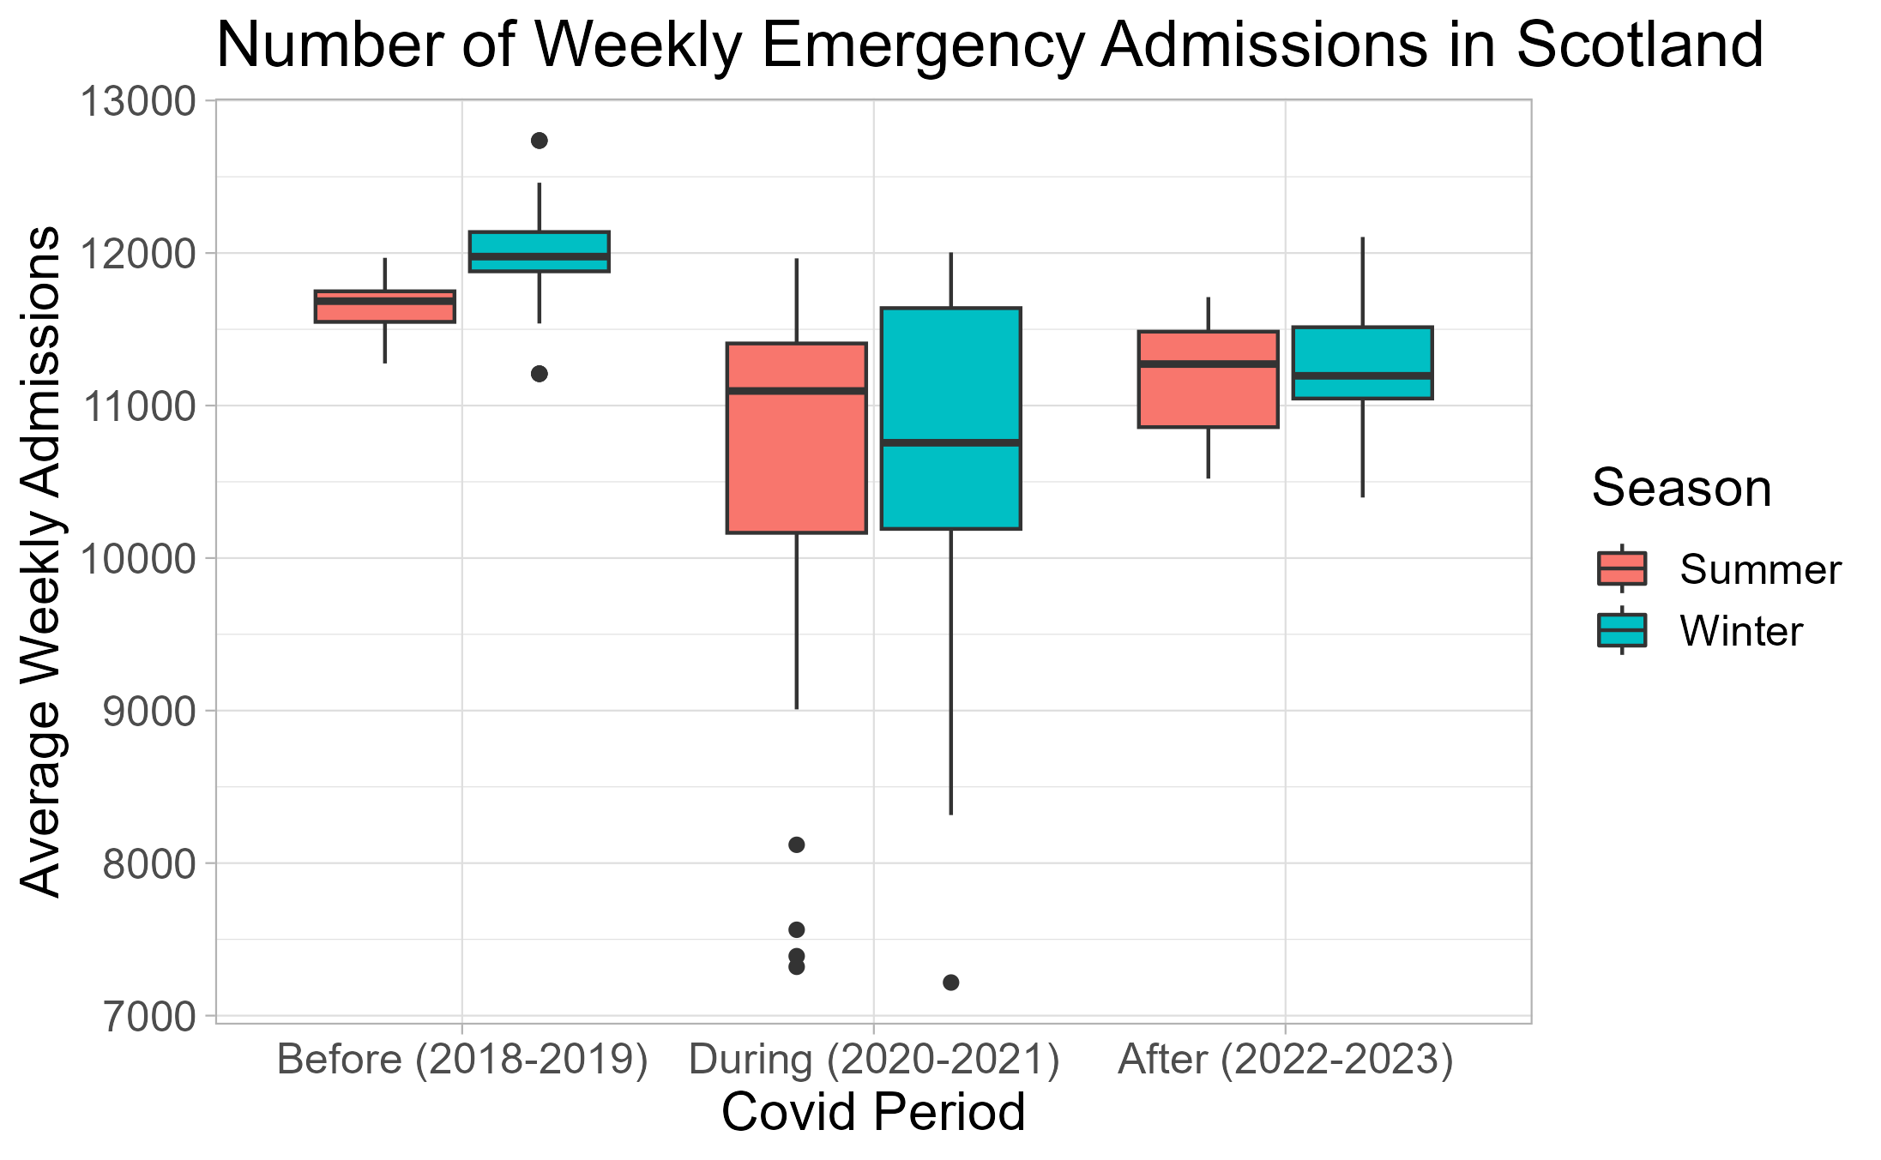
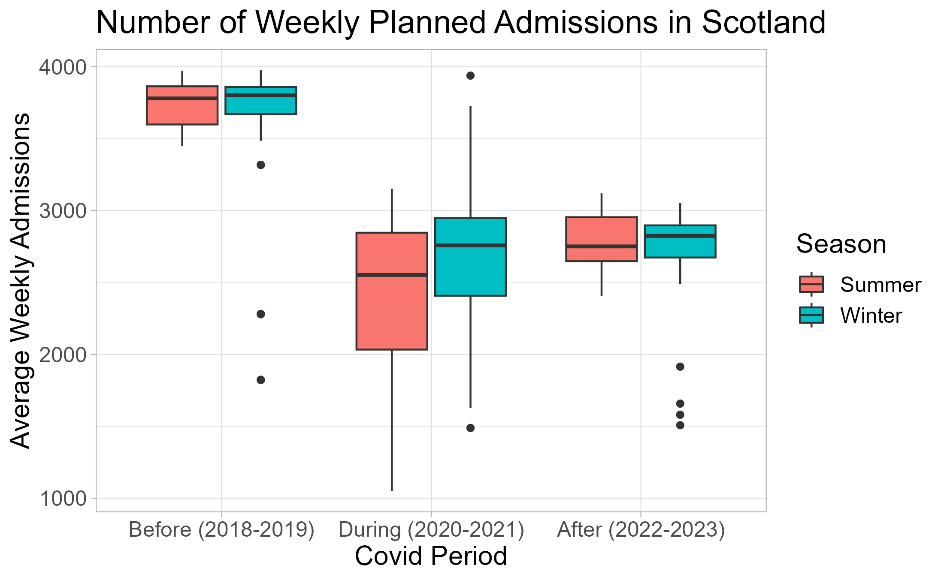
Number of Admissions

Slide 12
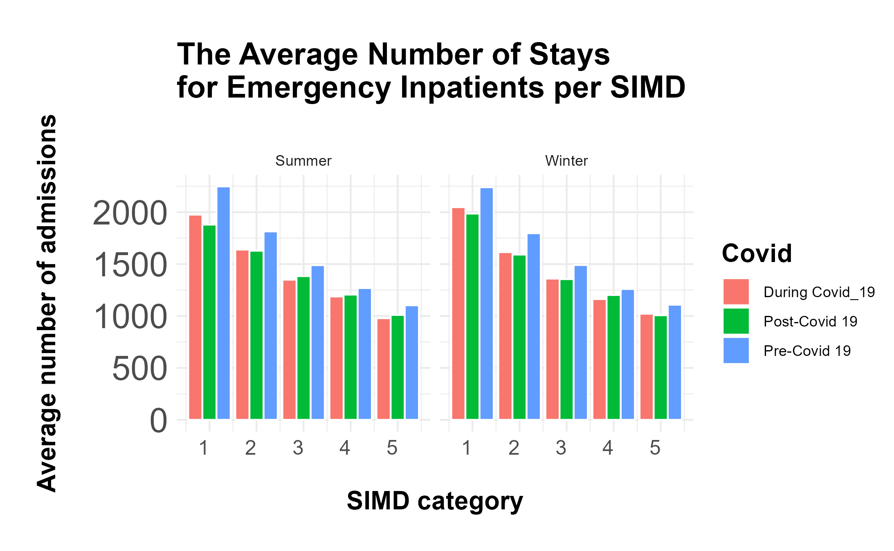

Slide 13
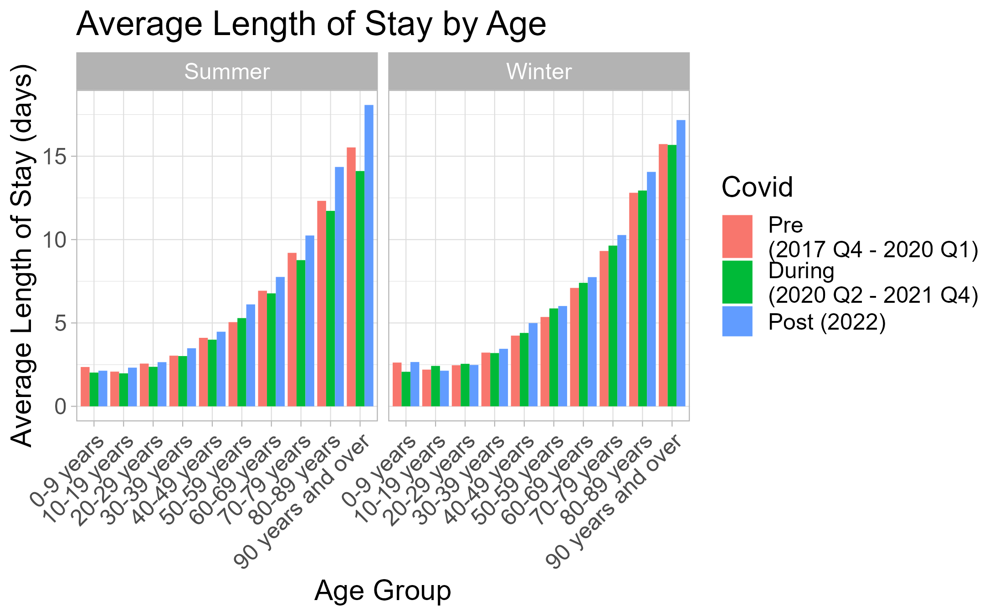
Length of Stay

Slide 14
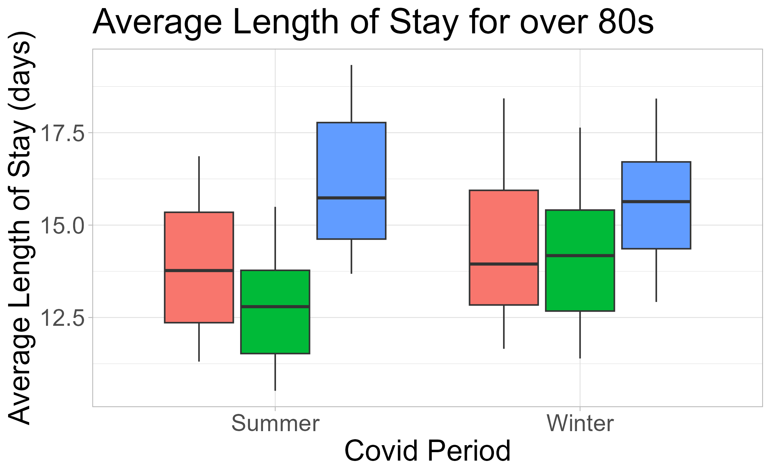

Slide 15
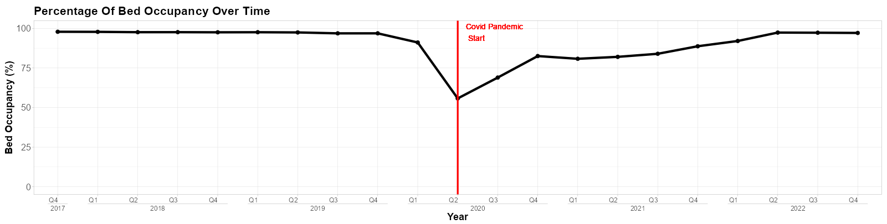
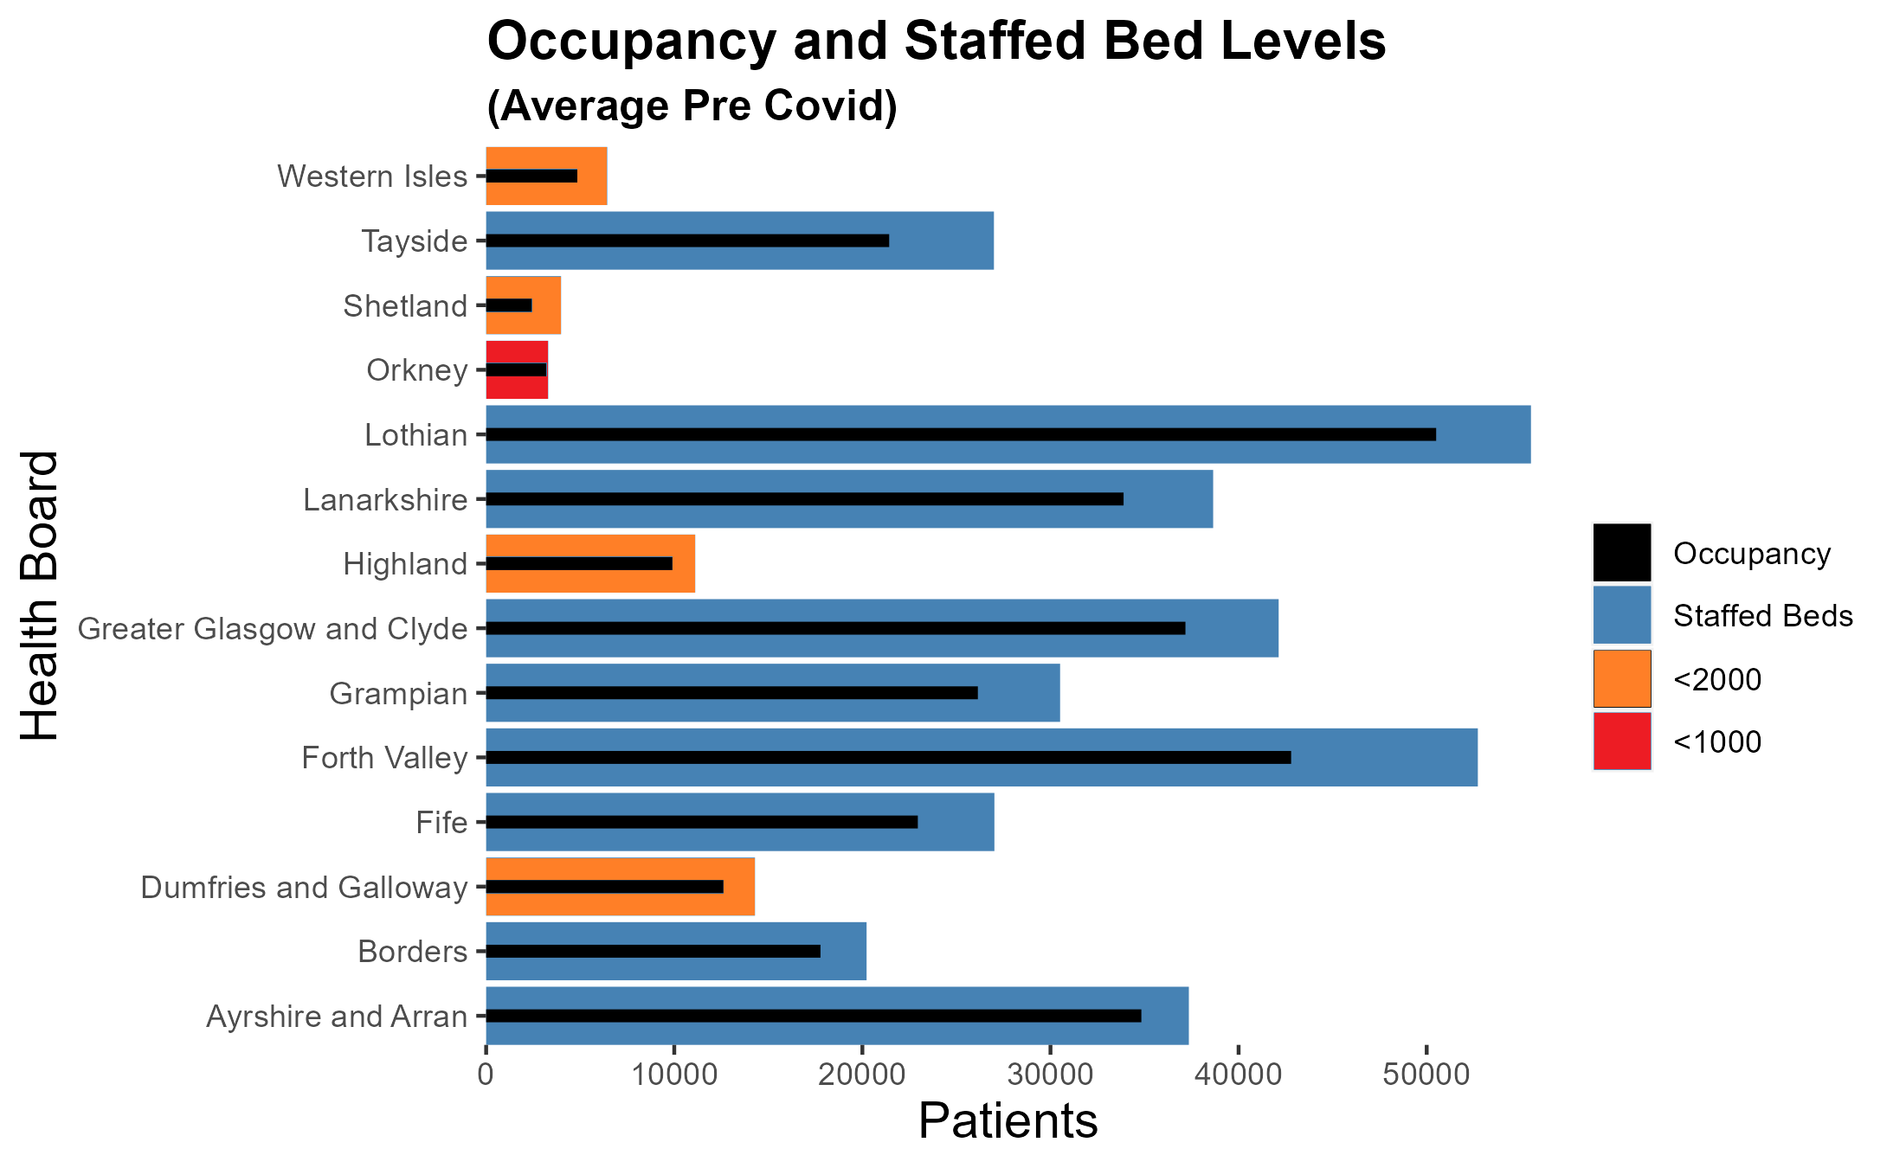
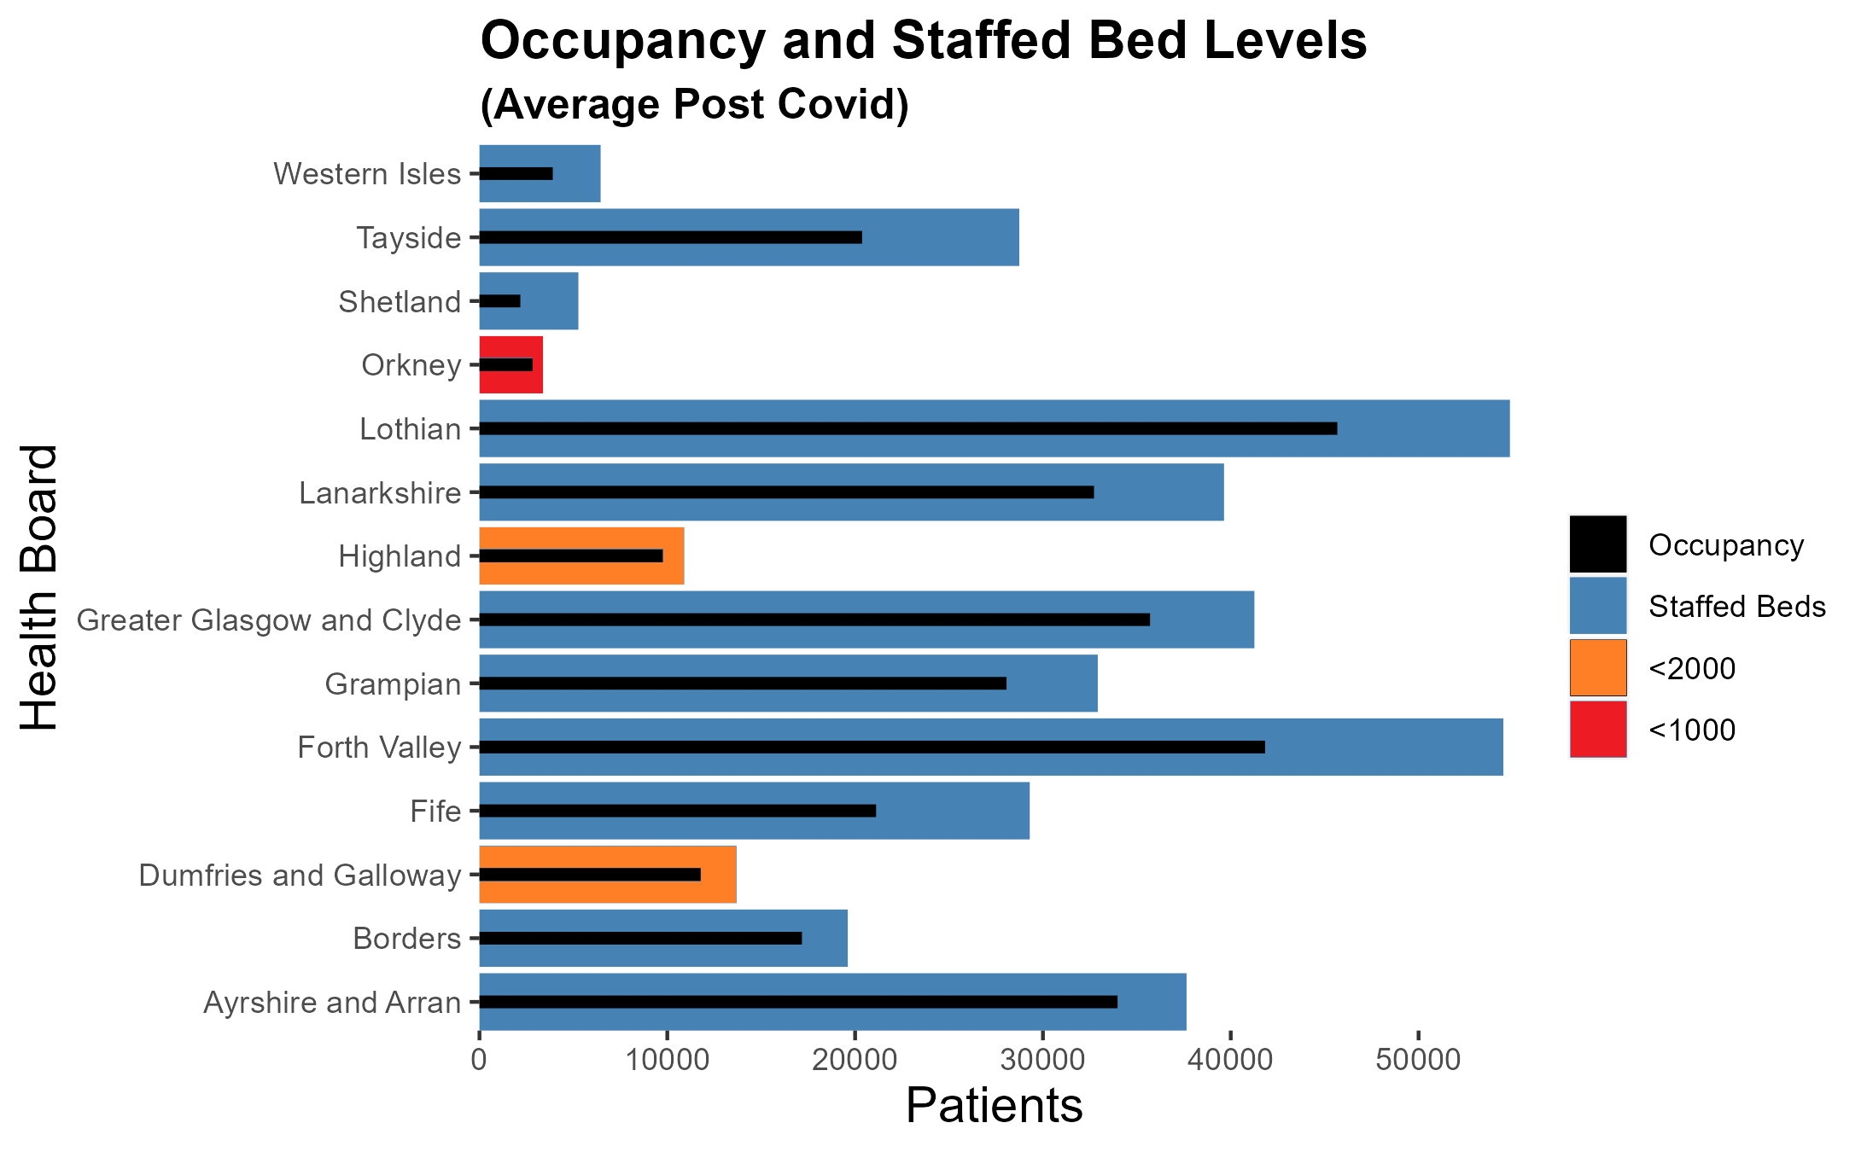
Bed Availability

Slide 17
What is Driving the Improvement?
Exceeding recruitment commitments
- April 2022 £4.5 million funding recruitment package.
- Recurring Scottish Government funding of £1 million targeted at overseas recruitment.
- Exceeded commitment to recruit additional health workers in key settings.
Improved staff conditions
- Invested £12 million to support well-being and further investment is planned.
- Invested in staff, through fair pay, increased training and upskilling opportunities.
Increased investment in training existing and new staff
- Introduced a number of new bursaries to widen access to careers in health and care.
- Established the NHS Scotland Academy which provides a broad range training opportunities
- Committed to increase medical undergraduates by 500 places

